Slide 1
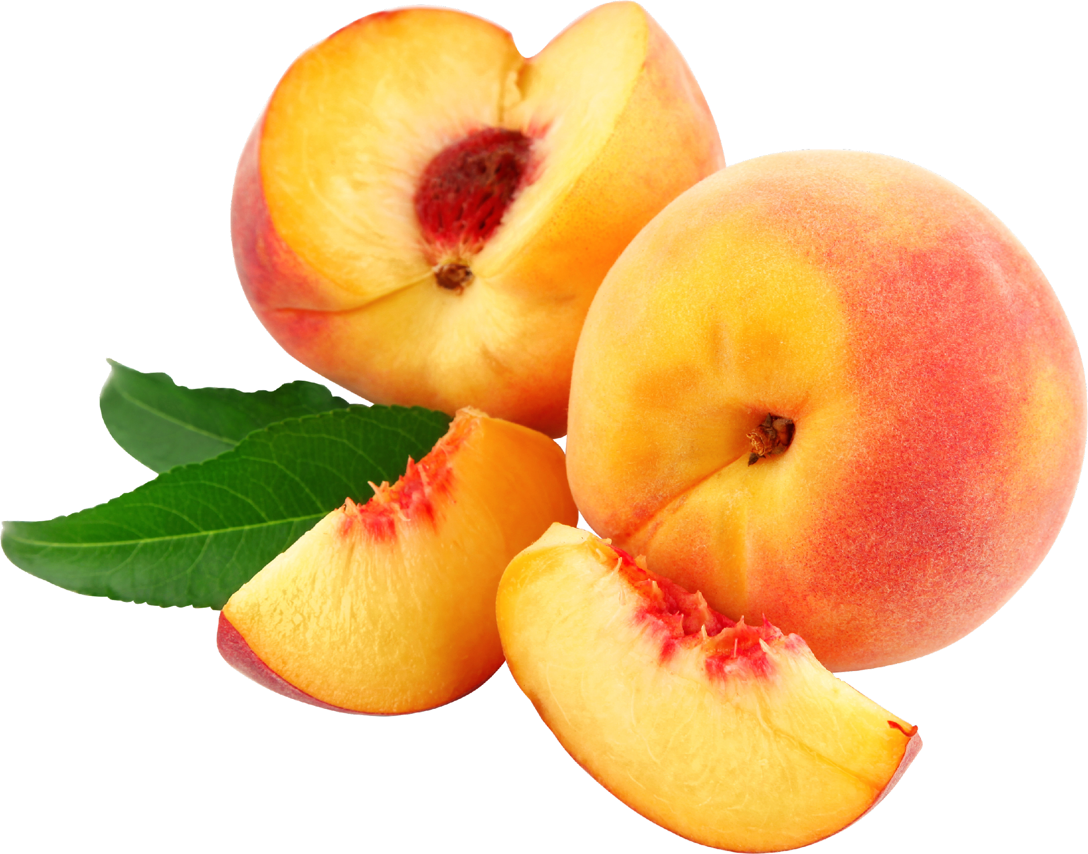
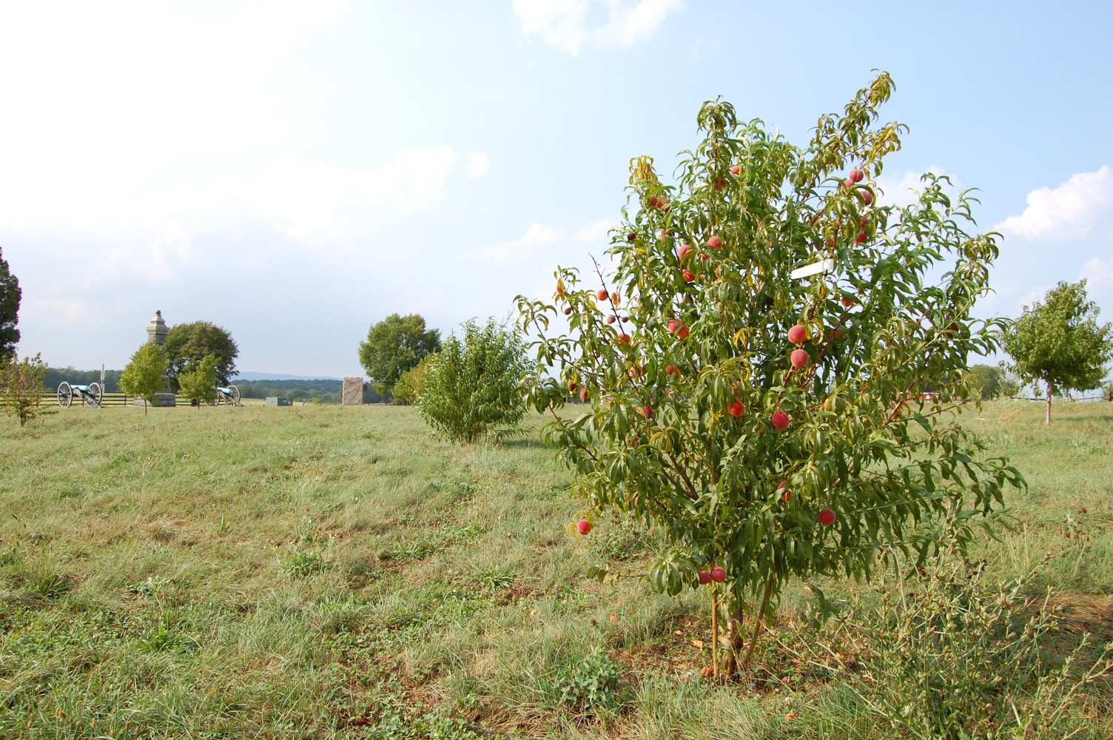
Peaches
A Virtual Field Trip

Slide 2
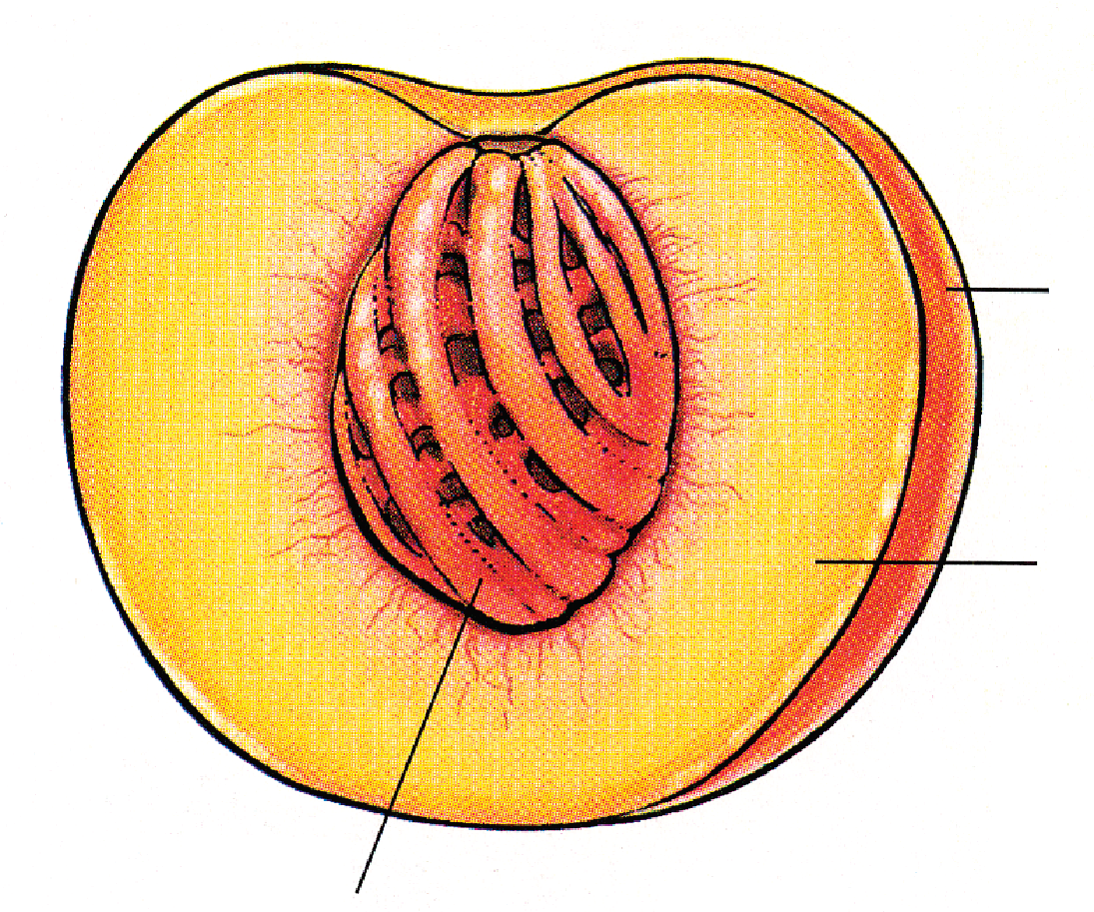
Part Of The Rose Family
Rosaceae is known as the Rose Family
Amygdaloideae is a subgroup of the Rosaceae that contains the genus, Prunus
Prunus persica is the botanical name for peach
Stone fruit (drupe) is a fruit that contains a single large seed or stone surrounded by juicy flesh
Skin
Pulp
2 peach stone types are Clingstone & Freestone
Stone (Pit)
Notes:
The picture on the right is the peach tree prior to bearing fruits. (flowers are present before the fruit) Picture Source: https://plantsam.com/prunus-persica/
https://homeguides.sfgate.com/peaches-flower-63025.html
Family: collection of plants that share characteristics; Plants that flower and fruit in similar ways are considered to be part of the same family.
Subgroup: a genre under the family, dividing them into smaller groups that share similar characteristics.
Genus: is the generic name, but not the species name. For example, Prunus is the generic name for stonefruit and Prunus persica is the specific scientific name for peach.
Botanical: the scientific name given to a particular plant species.
Botany: the scientific study of plants, including their physiology, structure, genetics, ecology, distribution, classification, and economic importance.
Drupe: The botanical name for stone fruit
https://www.canr.msu.edu/news/peaches_and_the_science_behind_them
In Clingstone: the flesh of the fruit clings to the stone/pit VS the Freestone: the flesh is easily removed/falls off (does not cling) from stone/pit.

Slide 3
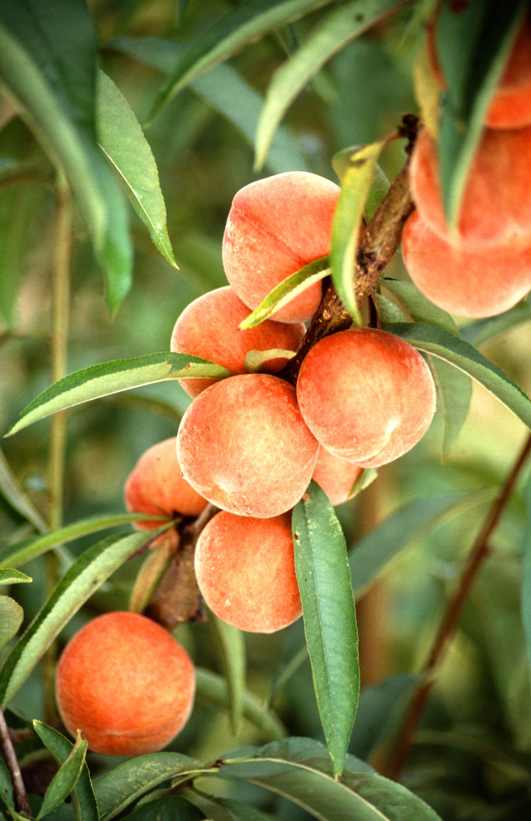
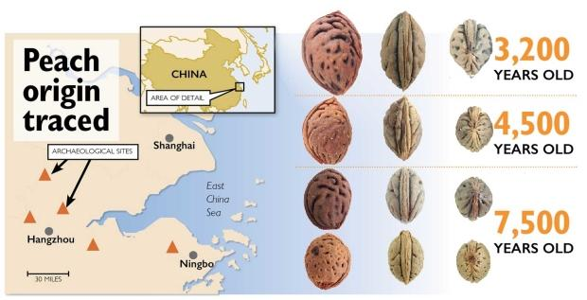
Origin & Travels
Originated in China over 7,000 years ago
The peach traveled west to Persia (Iran) where Great Alexander discovered it and introduced it to Greek & Roman society
Spaniards brought peaches to South America & Florida, the French introduced them to Louisiana and the English took them to their Jamestown & Massachusetts colonies
Notes:
https://www.froghollow.com/blogs/news/the-history-of-peaches-frog-hollow-farm-1
https://www.goodfruit.com/digging-back-into-peach-history/
How did the peach pit shown above evolve as it was cultivated from the wild?
https://www.canr.msu.edu/news/peaches_and_the_science_behind_them
The Romans thought peaches originated from Persia hence it’s botanical name Prunus persica.
Spain + France were part of Greek & Roman society
China is still the number one producer of peaches in the world
https://fruitguys.com/2013/08/ten-tasty-facts-you-probably-didnt-know-about-the-peach/

Slide 4
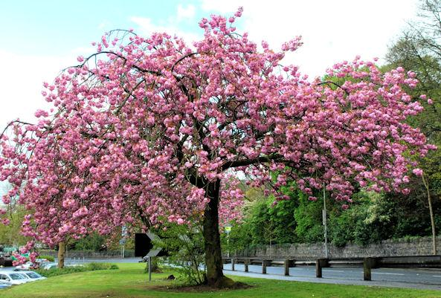
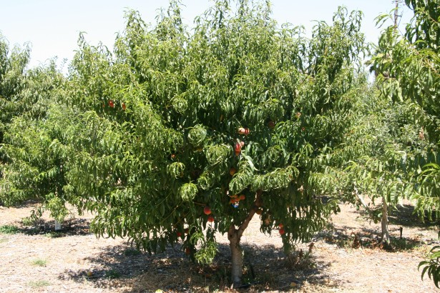
How Do Peaches Grow?
Peaches grow on peach trees that start as flowers that typically bloom 3-5 months before it fruits
The flowers have a strong, pleasant fragrance & vibrant colors that can range from white, pink, orange, red and violet
Most peach trees need 2-4 years before they grow to maturity and start producing fruit
Peach trees are expected to live 15-20 years
They are grown throughout warmer temperature regions of both the north & south hemispheres
Peaches are in season during June to September
Notes:
Grown throughout warmer temperature regions of both the north and south hemispheres.
https://homeguides.sfgate.com/peaches-flower-63025.html
https://greenupside.com/when-does-a-peach-tree-bear-fruit/
Most peach trees will need 2 to 4 years before they grow to maturity and start producing fruit. Dwarf varieties may start producing fruit 1 year sooner than standard size peach trees.
https://farmflavor.com/lifestyle/how-peaches-are-harvested-and-other-peach-fun-facts/

Slide 5
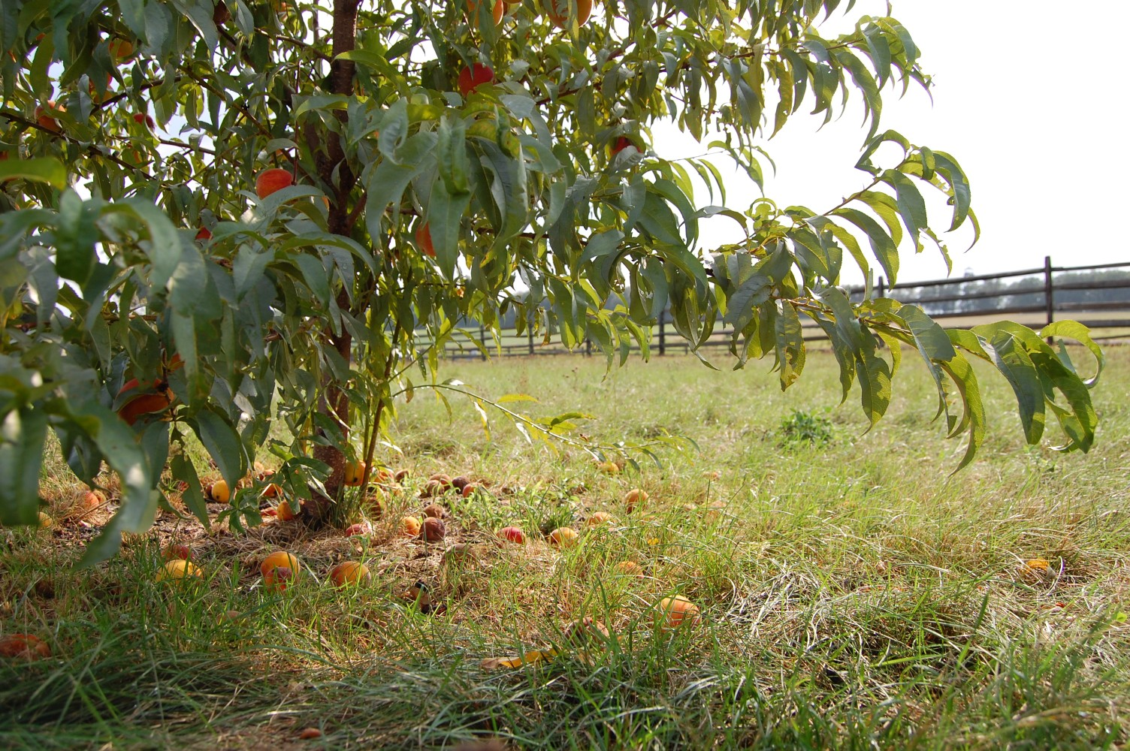
California Peaches
Georgia is known as the Peach State but California grows more peaches than any other state in the United States
California produces more than 50% of the peaches in the US and grows 175 different varieties
California peaches are grown in the Central Valley for the Mediterranean climate and rich soils
California Peaches are in season April to October
Notes:
https://fruitguys.com/2013/08/ten-tasty-facts-you-probably-didnt-know-about-the-peach/
https://www.cafarmtrust.org/peaches-theyre-a-ca-thang/
https://www.thenibble.com/reviews/main/fruits/peach-facts.asp
California produces more than 50% of the peaches in the United States (and grows 175 different varieties)
Season: April to October https://www.theproducenerd.com/2016/07/peaches-from-harvest-to-packing/

Slide 6
Local Farm Feature
Long Beach Unified School District sought out locally grown peaches
Most of the peaches in our schools this month are from Scattaglia Growers & Shippers (SGS)
Established in Littlerock, a city located in Los Angeles County
“Great Taste Delivered Well”
Their farm is in Traver, a city in Tulare County which is part of California’s Central Valley
They grow, pack and ship Cal­i­for­nia Stone Fruits & Table Grapes under labels Sun Joy, Sun Disk. Peak Value and Scattaglia Farms.
Their strategy in delivering the most flavorful eating experience to valued customers, each and every time they pick their fruit, is to wait until it's in its best condition before it is harvested.
Notes:
sgs.us.com
{website does not work on office web browser but works on phone browser}
“Great Taste Delivered Well” is their motto. Their strategy in delivering the most flavorful eating experience to valued customers each and every time they pick their fruit is to wait until it's in its best condition before it is harvested.
https://www.generalproduce.com/sustainability/locally/growers/944-sgs

Slide 7
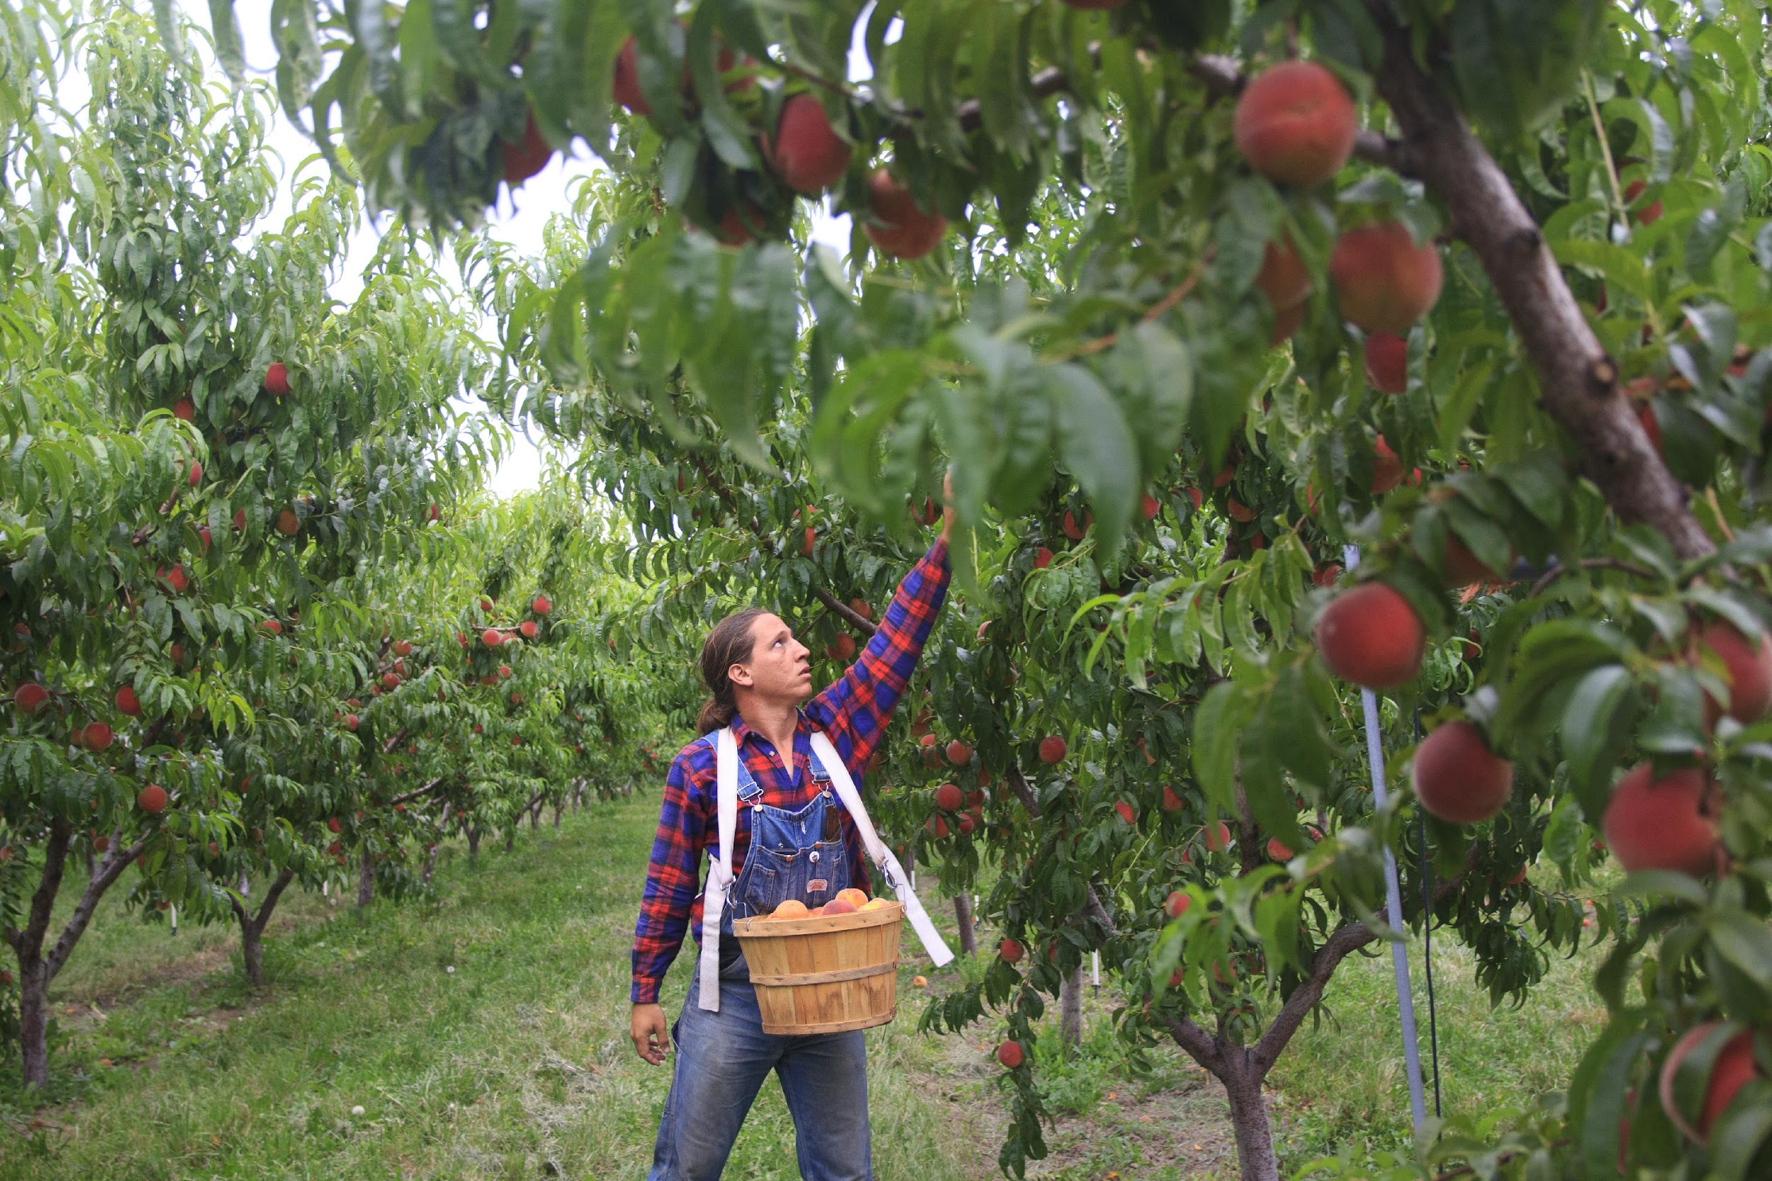
From Tree to Store
Peaches are picked by hand from the trees
To stop further ripening, peaches are immediately rinsed in cold water through a machine that acts as an ice-water bath
The next day, they are cleaned, defuzzed & sent through graders that remove leaves. The desirable peaches are packed & shipped in refrigerated trucks to arrive in stores
Peaches arrive in stores within 3 days of picking from the trees
Notes:
https://farmflavor.com/lifestyle/how-peaches-are-harvested-and-other-peach-fun-facts/
Peaches are picked by hand from the trees.
The peaches are immediately rinsed in cold water to stop any further ripening. They are run through hydro-cooler, essentially an ice-water bath that lowers the temperature of the peach to delay the ripening process so the fruit won’t be overripe when it reaches the consumer.
The next day, they are cleaned, defuzzed and sent through graders that remove leaves and cull the least desirable fruit. The remaining peaches are sorted by an electric sizer.
Finally, they are packed and shipped in refrigerated trucks to arrive in retail stores often within three days of picking.
https://www.theproducenerd.com/2016/07/peaches-from-harvest-to-packing/
Pic: http://www.idletheorybus.com/

Slide 8
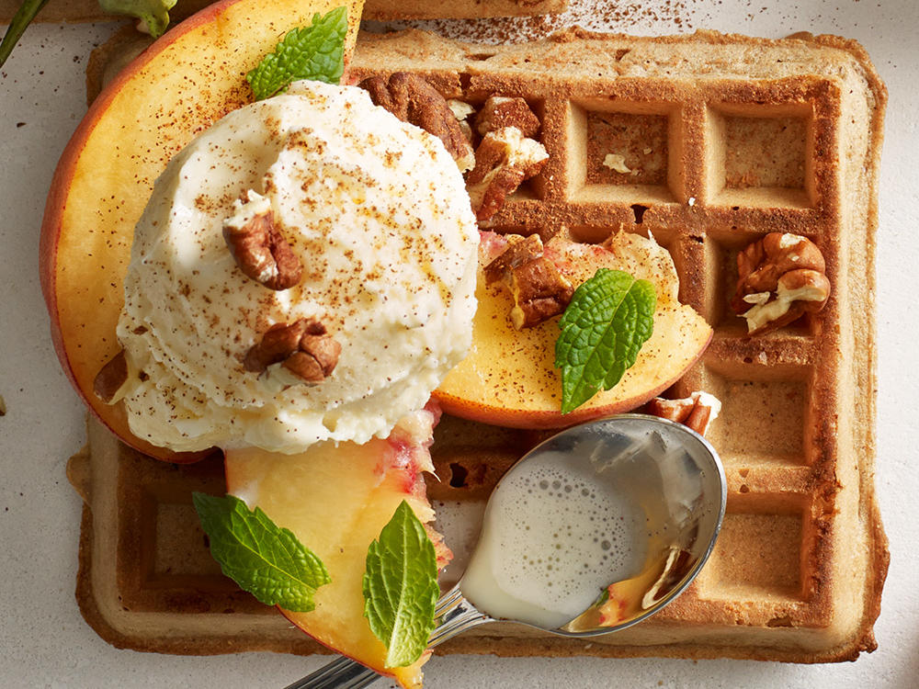
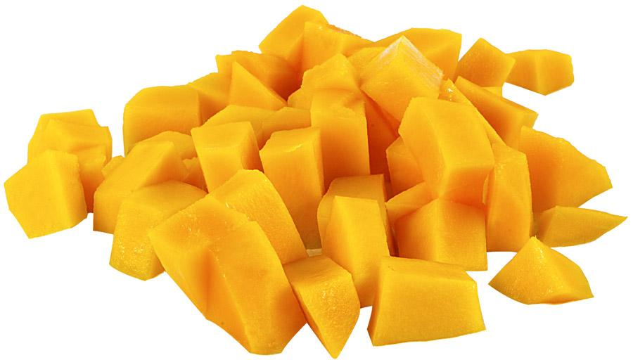
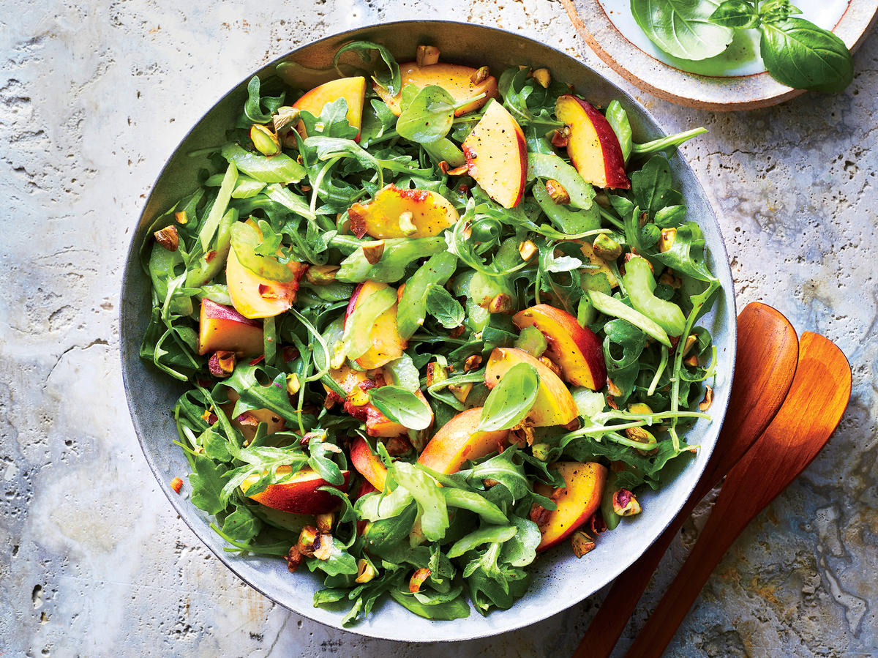
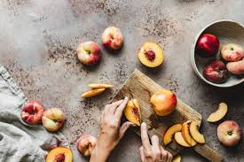
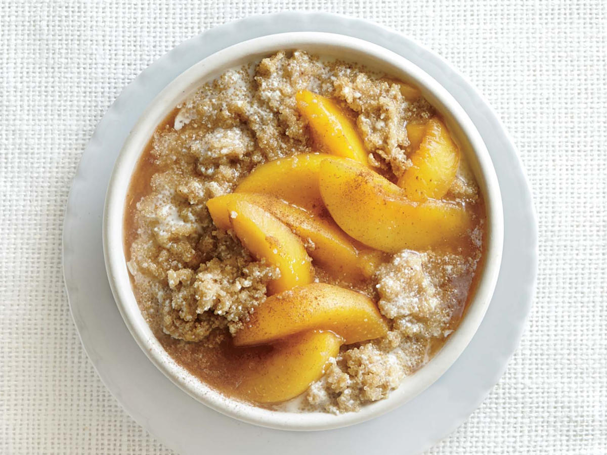
How to Store, Wash & Eat Peaches
Store on kitchen counter until ripe, then refrigerate
Rinse peach under cold water when ready to eat
Eat them whole, sliced, diced, raw, baked, grilled, frozen, in smoothies, salads & desserts
Notes:
https://pearsonfarm.com/pages/storage-nutrition-facts
https://www.cookinglight.com/food/in-season/peach-recipes {pics}
They can be eaten raw, baked, grilled, broiled, or sautéed and are easily incorporated into warm or cold dishes alike.

Slide 9
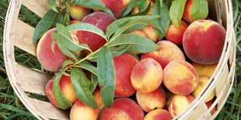
How Much Do You Need?
Recommended Daily Fruit Intake by Age
What counts as 1 cup of peach?
 | Ages | Servings
Children | 2-4 | 1 to 1 ½ cup
 | 5-8 | 1 to 2 cups
Girls | 9-13 | 1 ½- 2 cups
 | 14-18 | 1 ½- 2 cups
Boys | 9-13 | 1 ½ to 2 cups
 | 14-18 | 2 to 2 ½ cups
1 large peach
1 cup, sliced or diced, fresh, cooked, frozen or canned, drained
2 halves, canned
Notes:
https://www.myplate.gov/eat-healthy/fruits

Slide 10
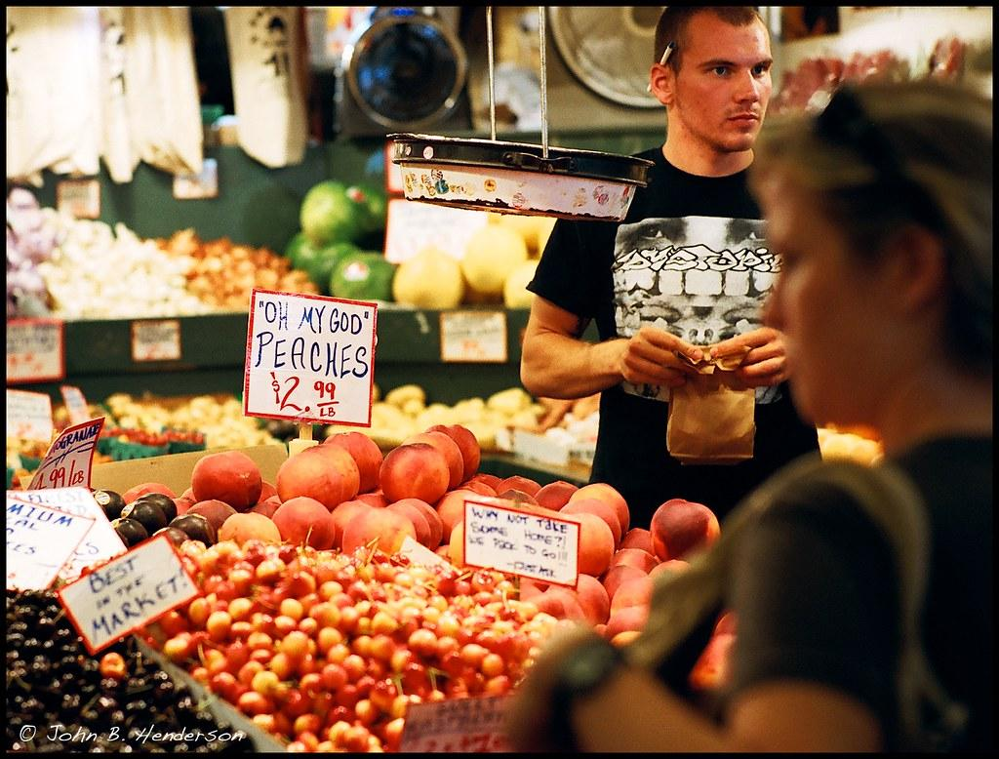
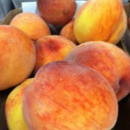
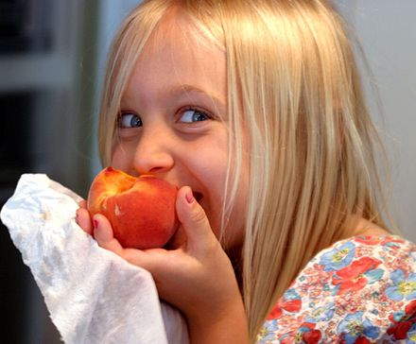
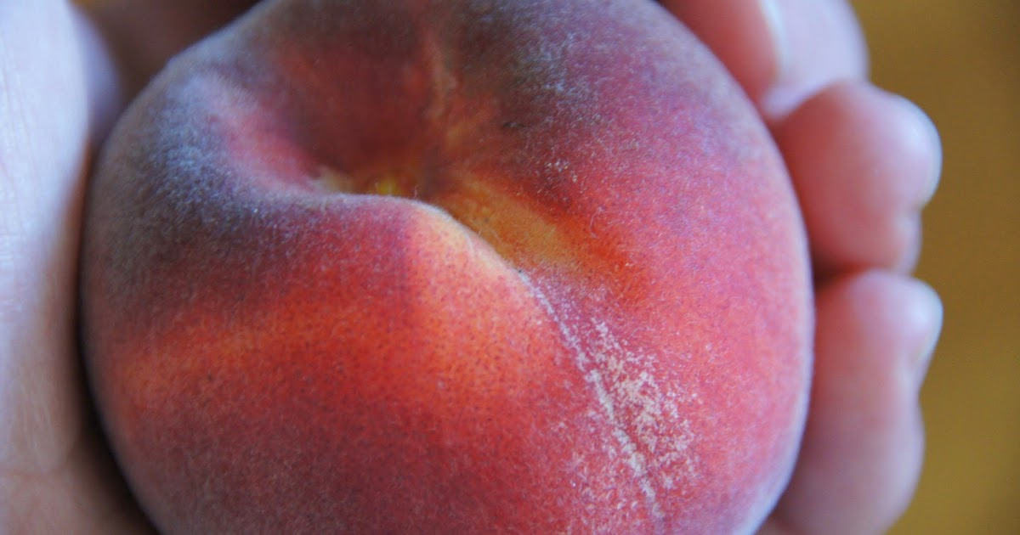
How To Pick Them Ripe
Look for vibrant yellow-orange background that is partially or fully covered by deep red
The red color comes from direct sun exposure
Feel for firm yet slightly soft peaches with no extreme tender areas or bruises
Smell for pleasantly sweet aroma
Notes:
A ripe peach has a dark yellow color. It’s not necessarily red, that’s simply the color that comes from direct sun exposure. If the peach is green or even has any hint of green left on it, it needs more time on the tree. A green peach is certainly edible but it’s not going to be as sweet and juicy.
https://parleefarms.com/peach-ripe-eating/

Slide 11
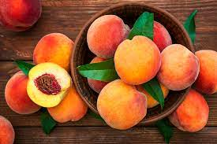
Just Peachy
Nutritional Facts
1 medium peach contains 2 grams of fiber
10% the DV of Vitamin A & is especially high in beta carotene
17% the DV of Vitamin C (ascorbic acid)
Vitamin A & Vitamin C are antioxidants
8% the DV of Potassium
a mineral, electrolyte & element K on the periodic table
Health Benefits
Aids digestion & helps with satiety
Supports night vision & keeps skin healthy
Helps wound healing & strengthens the immune system
Eliminates free radicals (toxins)
Regulates fluids, muscle contractions & sends nerve signals
Notes:
Percent Daily Value (DV): is a reference to the amount of the nutrient that’s in the product based off the recommended daily value set for that specific nutrient. It can tell you if a serving of food is high or low in a nutrient & if the food contributes a little or a lot to your daily diet for each nutrient. *it is shown on nutrition labels & is (usually) located to the right of each nutrient. *
https://www.fda.gov/food/new-nutrition-facts-label/how-understand-and-use-nutrition-facts-label
General Guide to %DV
5% DV or less of a nutrient per serving is considered low
20% DV or more of a nutrient per serving is considered high
More often, choose foods that are:
Higher in %DV for Dietary Fiber, Vitamin D, Calcium, Iron, and Potassium
Lower in %DV for Saturated Fat, Sodium, and Added Sugars
Betacarotene: a compound that gives vivid yellow, orange, and red coloring to vegetables. Our body converts it to vitamin A.
Ascorbic acid: scientific name for vitamin C
Antioxidant: Neutralizes free radicals; protects your cells from free radicals
https://www.healthline.com/nutrition/peach-fruit-benefits
Peach flowers also provide certain compounds that appear to support a healthy gut.
Fiber: 2 grams
Vitamin C: 17% of the Daily Value (DV)
Vitamin A: 10% of the DV
Potassium: 8% of the DV
https://healthfully.com/238217-what-vitamins-do-peaches-have.html
https://www.healthline.com/nutrition/what-does-potassium-do
https://fdc.nal.usda.gov/fdc-app.html#/food-details/325430/nutrients

Slide 12
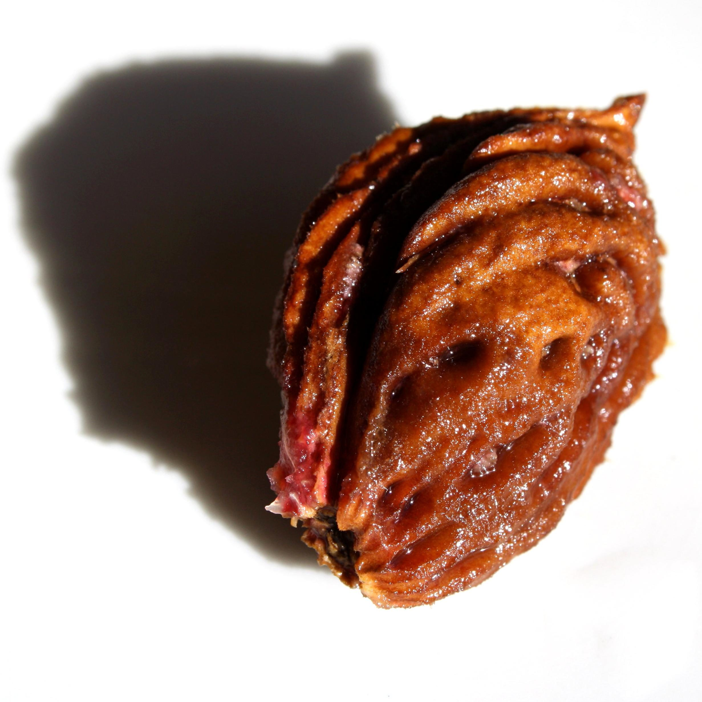
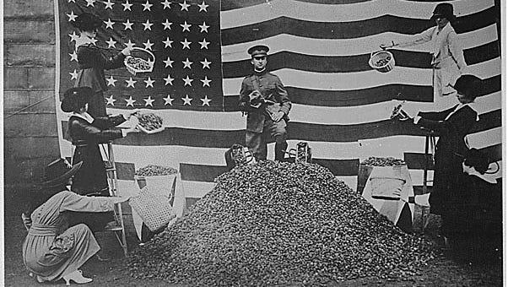
Fun Facts
Est 1918
“Do Your Bit – Save the Pit.”
Chemical warfare was used during World War I
Mustard gas caused injuries + death
Peach pits were used as filters in gas masks
Once burned, charcoal was extracted and used in the creation of the masks' charcoal filters which neutralized the poisonous gases
200 peach stones made enough carbon for 1 mask
Notes:
In World War I, peach pits were used as filters in gas masks.
https://www.indystar.com/story/news/history/retroindy/2018/04/20/how-peach-pits-helped-us-win-great-war/519938002/
Garner perfected an air-filtration system on a mask designed by his wife, Glenna, that used charcoal filters which absorbed sulphur dioxide and ammonia.
The fruit seeds were burned and charcoal was extracted, it could be used in the creation of the masks' charcoal filters which neutralized the poisonous gases. Two hundred peach stones made enough carbon for one mask.
The Gas Defense Division of the Chemical Warfare Service of the U.S. Army made a plea to American households: SAVE PEACH STONES AND NUTSHELLS FOR UNCLE SAM and incorporating the credo, “Do Your Bit – Save the Pit.”
Restaurants and hotels joined Indianapolis department stores L.S. Ayres & Co., William H. Block, H.P. Wasson and the Star Store as repositories for the donated pits in Indianapolis. Block’s labeled their collection site as the Liberty Peach Stone Barrel. The Red Cross led the campaign, which enlisted the help of churches, schools, Scouts and organizations, which staged their own pit crusades.
In this photo, taken on a September 1918 day in Boston, a proud military officer stands tall on top of a pile of something that would save thousands of lives on European battle fronts -- peach pits. Yes, peach pits.

Slide 13
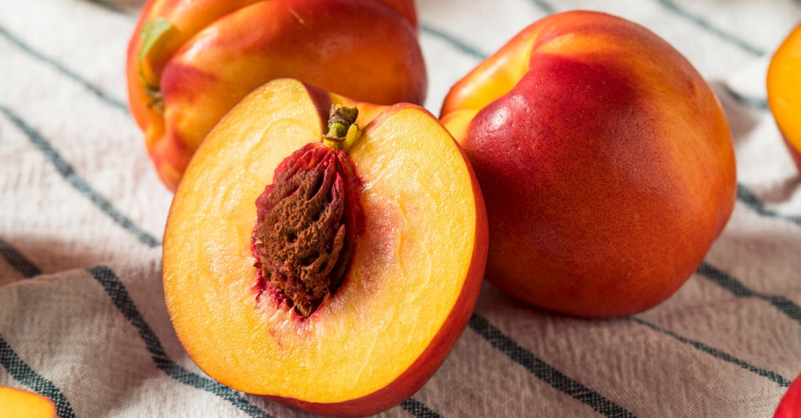
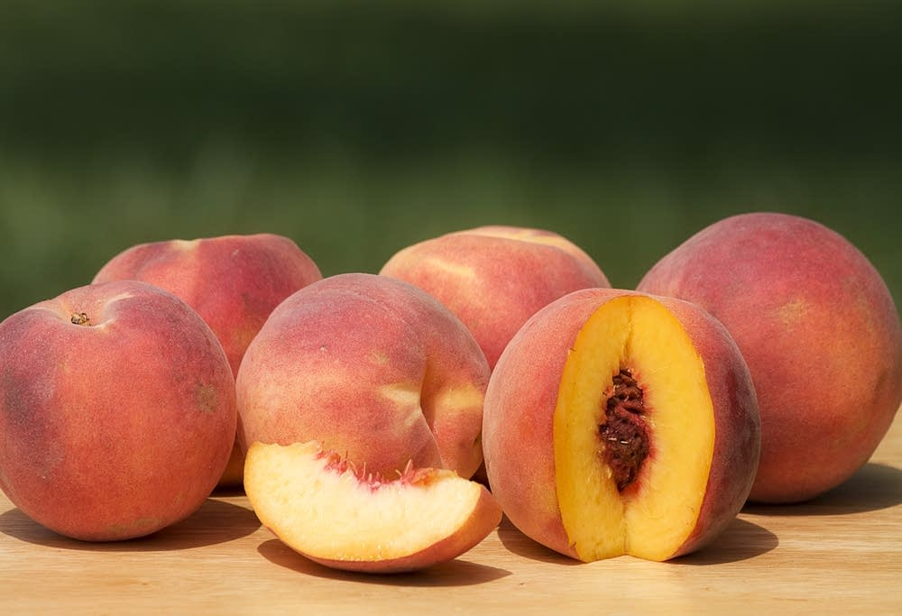
Fun Facts
Peaches & Nectarines are twins!
They are identical except one has fuzzy skin, the other has smooth
They are so genetically similar that they have been known to grow on the same tree
Nectarines have a recessive gene that causes them to shed the fuzz resulting in hairless smooth skin
Nectarines
Peaches
Notes:
genetically almost identical, with just one gene that's either dominant (in peaches) or recessive (in nectarines) that determines whether the skin is fuzzy or smooth.
https://colorfulplates.co/tips-tricks/whats-the-difference-between-peaches-and-nectarines/

Slide 14
I Am the Peach
https://www.youtube.com/watch?v=xfXZSDmz0sY
2 minute read along video
Notes:
https://www.youtube.com/watch?v=xfXZSDmz0sY

Slide 15
References
California Farmland Trust
/https://www.cafarmtrust.org/peaches-theyre-a-ca-thang
Farm Flavor
https://farmflavor.com/lifestyle/how-peaches-are-harvested-and-other-peach-fun-facts/
Frog Hollow Farm
https://www.froghollow.com/blogs/news/the-history-of-peaches-frog-hollow-farm-1
FDA
https://www.fda.gov/food/new-nutrition-facts-label/how-understand-and-use-nutrition-facts-label/
Fruit Guys
https://fruitguys.com/2013/08/ten-tasty-facts-you-probably-didnt-know-about-the-peach/
General Produce- Local Growers
https://www.generalproduce.com/sustainability/locally/growers/944-sgs
Good Fruit Grower
https://www.goodfruit.com/digging-back-into-peach-history/
Notes:
Info from:
https://homeguides.sfgate.com/peaches-flower-63025.html
https://www.canr.msu.edu/news/peaches_and_the_science_behind_them
https://www.froghollow.com/blogs/news/the-history-of-peaches-frog-hollow-farm-1
https://www.goodfruit.com/digging-back-into-peach-history/
https://greenupside.com/when-does-a-peach-tree-bear-fruit/
https://farmflavor.com/lifestyle/how-peaches-are-harvested-and-other-peach-fun-facts/
https://fruitguys.com/2013/08/ten-tasty-facts-you-probably-didnt-know-about-the-peach/
https://www.cafarmtrust.org/peaches-theyre-a-ca-thang/
https://www.thenibble.com/reviews/main/fruits/peach-facts.asp
* https://www.theproducenerd.com/2016/07/peaches-from-harvest-to-packing/
https://pearsonfarm.com/pages/storage-nutrition-facts
https://www.myplate.gov/eat-healthy/fruits
https://parleefarms.com/peach-ripe-eating/
https://www.fda.gov/food/new-nutrition-facts-label/how-understand-and-use-nutrition-facts-label
https://www.healthline.com/nutrition/peach-fruit-benefits
https://healthfully.com/238217-what-vitamins-do-peaches-have.html
https://fdc.nal.usda.gov/fdc-app.html#/food-details/325430/nutrients
https://www.healthline.com/nutrition/what-does-potassium-do
https://www.indystar.com/story/news/history/retroindy/2018/04/20/how-peach-pits-helped-us-win-great-war/519938002/

Slide 16
References
Green Upside
https://greenupside.com/when-does-a-peach-tree-bear-fruit/
Harvest of the Month
http://www.harvestofthemonth.com
Healthfully
https://healthfully.com/238217-what-vitamins-do-peaches-have.html
Healthline
https://www.healthline.com/nutrition/peach-fruit-benefits
Indy Star
https://www.indystar.com/story/news/history/retroindy/2018/04/20/how-peach-pits-helped-us-win-great-war/519938002/
Michigan State University
https://www.canr.msu.edu/news/peaches_and_the_science_behind_them
MyPlate
https://www.myplate.gov/eat-healthy/fruits
Notes:
Info from:
https://homeguides.sfgate.com/peaches-flower-63025.html
https://www.canr.msu.edu/news/peaches_and_the_science_behind_them
https://www.froghollow.com/blogs/news/the-history-of-peaches-frog-hollow-farm-1
https://www.goodfruit.com/digging-back-into-peach-history/
https://greenupside.com/when-does-a-peach-tree-bear-fruit/
https://farmflavor.com/lifestyle/how-peaches-are-harvested-and-other-peach-fun-facts/
https://fruitguys.com/2013/08/ten-tasty-facts-you-probably-didnt-know-about-the-peach/
https://www.cafarmtrust.org/peaches-theyre-a-ca-thang/
https://www.thenibble.com/reviews/main/fruits/peach-facts.asp
* https://www.theproducenerd.com/2016/07/peaches-from-harvest-to-packing/
https://pearsonfarm.com/pages/storage-nutrition-facts
https://www.myplate.gov/eat-healthy/fruits
https://parleefarms.com/peach-ripe-eating/
https://www.fda.gov/food/new-nutrition-facts-label/how-understand-and-use-nutrition-facts-label
https://www.healthline.com/nutrition/peach-fruit-benefits
https://healthfully.com/238217-what-vitamins-do-peaches-have.html
https://fdc.nal.usda.gov/fdc-app.html#/food-details/325430/nutrients
https://www.healthline.com/nutrition/what-does-potassium-do
https://www.indystar.com/story/news/history/retroindy/2018/04/20/how-peach-pits-helped-us-win-great-war/519938002/

Slide 17
References
Parlee Farms
https://parleefarms.com/peach-ripe-eating/
Pearson Farm
https://pearsonfarm.com/pages/storage-nutrition-facts
SF Gate
https://homeguides.sfgate.com/peaches-flower-63025.html
SGS- Scattaglia Grow­ers & Shippers
https://sgs.us.com
The Nibble
https://www.thenibble.com/reviews/main/fruits/peach-facts.asp
The Produce Nerd
https://www.theproducenerd.com/2016/07/peaches-from-harvest-to-packing/
USDA
https://fdc.nal.usda.gov/fdc-app.html#/food-details/325430/nutrients
Notes:
https://www.fda.gov/food/new-nutrition-facts-label/how-understand-and-use-nutrition-facts-label
https://www.healthline.com/nutrition/peach-fruit-benefits
https://healthfully.com/238217-what-vitamins-do-peaches-have.html
https://fdc.nal.usda.gov/fdc-app.html#/food-details/325430/nutrients
https://www.indystar.com/story/news/history/retroindy/2018/04/20/how-peach-pits-helped-us-win-great-war/519938002/

